Slide 1
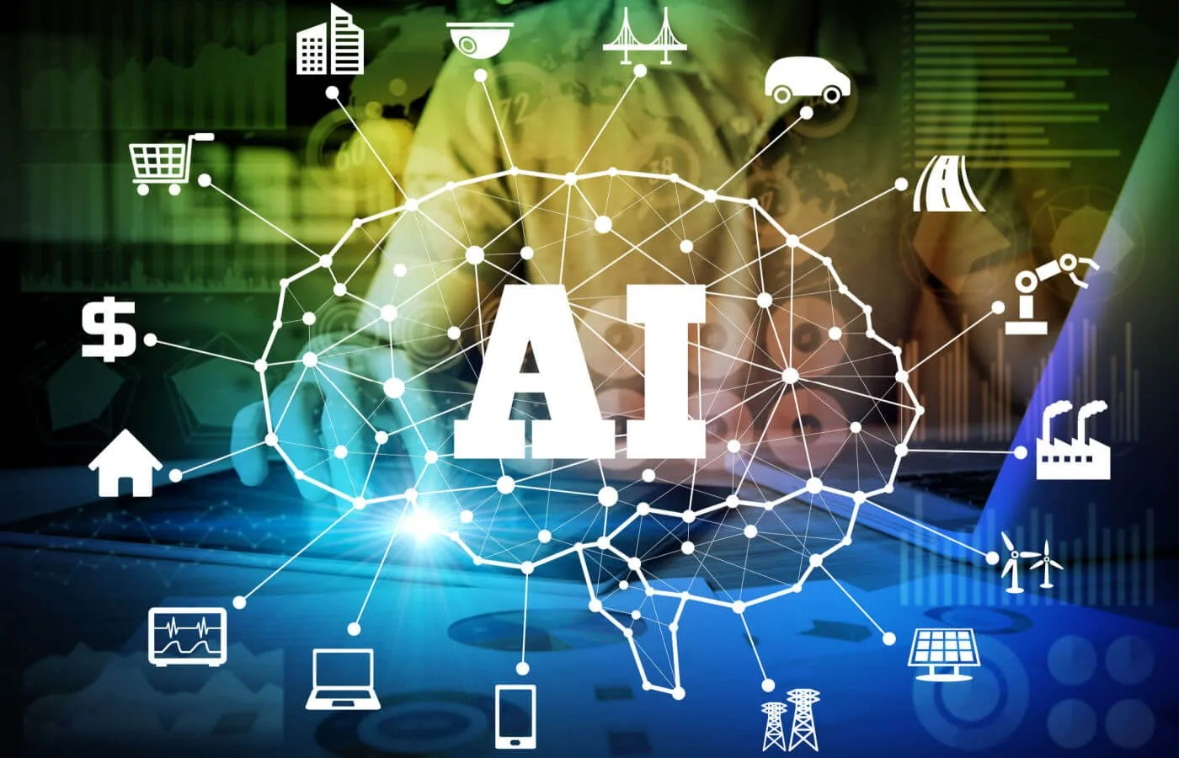
Introduction to Artificial Intelligence
• AI focuses on designing systems that replicate human cognitive capabilities
• Leverages machine learning, deep learning, and natural language understanding
• Enables machines to interpret data, identify trends, and make decisions
• Widespread integration across multiple sectors
• Challenges include data privacy, fairness, and accountability

Slide 2
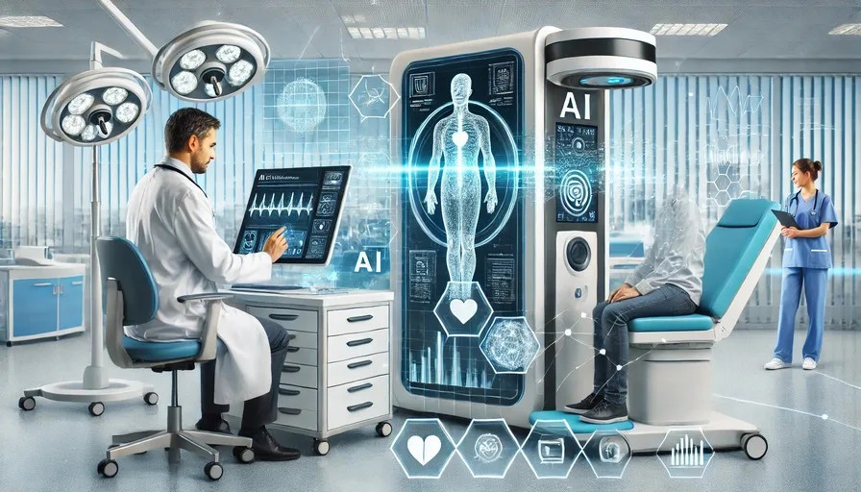
AI in Healthcare - Overview
• Revolutionizing medical field with innovative solutions
• Enhances patient care and streamlines operations
• Improves diagnostic accuracy through advanced algorithms
• Enables early disease detection and pattern recognition

Slide 3
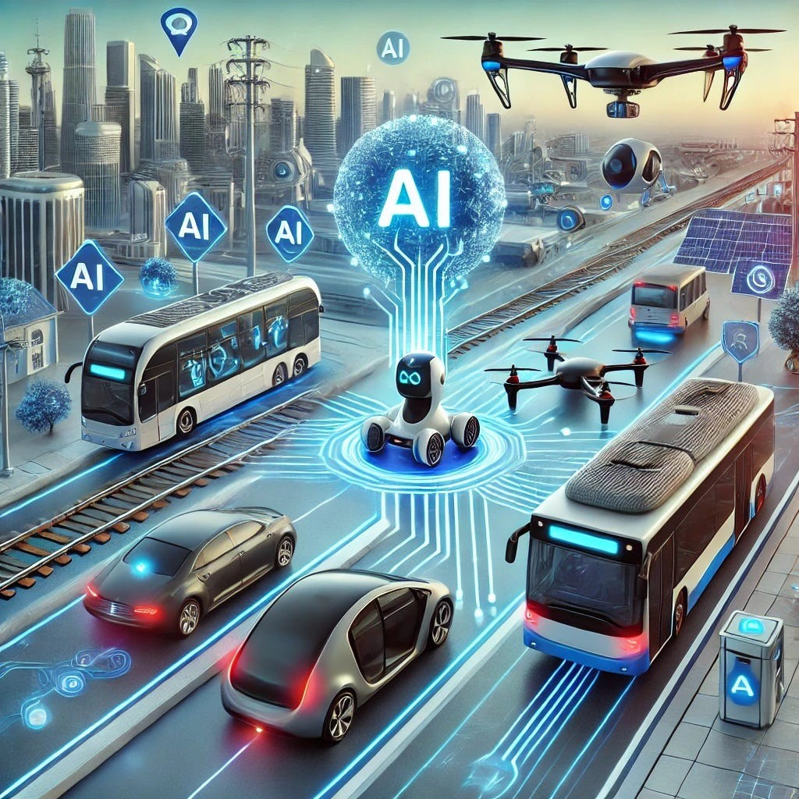
AI in Healthcare - Applications
• Medical imaging interpretation using neural networks
• Robotic surgery for enhanced precision
• AI-driven predictive analytics for resource allocation
• Personalized medicine and treatment planning
• Support for healthcare professional decision-making

Slide 4
AI in Education
• Creates personalized learning experiences
• Adaptive learning platforms for individual pacing
• Intelligent tutoring systems with real-time feedback
• Automated grading and administrative assistance
• Early identification of at-risk students
• Language translation and accessibility tools

Slide 5
AI in Transportation
• Enhanced safety, efficiency, and sustainability
• Real-time analysis of traffic patterns and conditions
• Autonomous vehicles for improved road safety
• Smart public transit scheduling and route planning
• AI-driven logistics and supply chain optimization
• Environmental sustainability and emission reduction

Slide 6
AI in Finance
• Advanced analytics for market predictions
• Real-time fraud detection
• Personalized banking experiences
• AI-powered chatbots and recommendation systems
• Algorithmic trading capabilities
• Enhanced risk management

Slide 7
ML Workflow - Data Preprocessing
• Data Cleaning: Handle missing values and outliers
• Data Transformation: Normalize and standardize data
• Feature Engineering: Create informative features
• Encoding Categorical Data: Convert to numerical format
• Feature Selection: Identify relevant features
• Data Splitting: Create training, validation, and test sets

Slide 8
ML Workflow - Model Training
• Feed training data into ML algorithms
• Tune model parameters and weights
• Minimize loss function through optimization
• Use techniques like gradient descent
• Map input features to output labels
• Learn patterns and relationships in data

Slide 9
ML Workflow - Model Evaluation
• Assess models using validation set
• Apply appropriate performance metrics
• Perform hyperparameter tuning
• Balance overfitting and underfitting
• Use techniques like grid search and random search
• Monitor model generalization ability

Slide 10
ML Workflow - Model Selection & Testing
• Select best performing model on validation set
• Consider model simplicity and interpretability
• Evaluate resource requirements
• Test on unseen data
• Assess real-world performance
• Consider practical deployment factors

Slide 11
AI Across Domains - Summary
Domain | Key Applications | Benefits | Challenges
Healthcare | Early disease diagnosis, personalized treatment, medical imaging, robotic surgery | Improved accuracy, efficiency, patient outcomes, and resource allocation | Data privacy, regulatory requirements, need for human oversight
Education | Adaptive learning, intelligent tutoring, automated grading, performance analytics | Personalized learning, increased accessibility, early intervention, administrative support | Data ethics, equitable access, over-reliance on technology
Transportation | Autonomous vehicles, route optimization, public transit planning, logistics AI | Enhanced safety, reduced congestion, cost-efficiency, smarter cities | Regulatory hurdles, cybersecurity, public trust
Finance | Fraud detection, algorithmic trading, personalized banking, risk management | Real-time insights, improved customer service, efficiency, fraud prevention | Algorithmic bias, ethical concerns, data protection, regulatory compliance
Key applications and challenges across sectors:
• Healthcare: Early diagnosis, personalized treatment
• Education: Adaptive learning, automated support
• Transportation: Autonomous vehicles, route optimization
• Finance: Fraud detection, algorithmic trading

Slide 12
Thank You!
We appreciate your attention. Looking forward to your questions!

